Slide 1
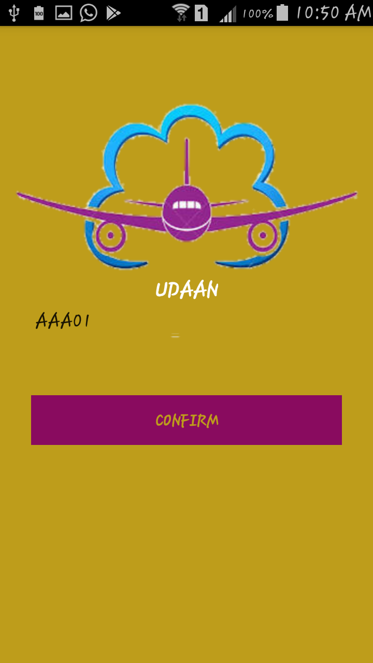
Presented by:
Team: The_Dreamers
Aakansha Rathore
Anamika Tripathi
Shubhi Lohani

Slide 2
ProblemS
Bell service disturbs fellow passengers
Airplane crew has to do multiple rounds to cater to passenger’s request
Cannot have food of their choice

Slide 3
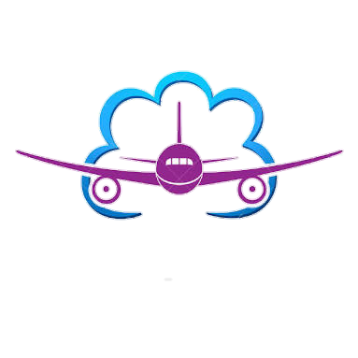
THEME
In- flight service management

Slide 4
SOLUTION
One- stop app for passenger
Connects to local server present in flight
Digitalize the service management in airline
Can call/request crew member via this app with just a tap
Place food order of your choice using digitalized menu
Safety manual just a click away
Know about in-flight facilities availability like vacancy of washroom

Slide 5
Udaan
Android app for fellow passengers in same flight
Connected to a crew app that keeps tab on the request
Have 4 main features:
Request/ report to fellow passenger
E-Menu
E- Safety Module
Inflight Facilities (include IoT)

Slide 6
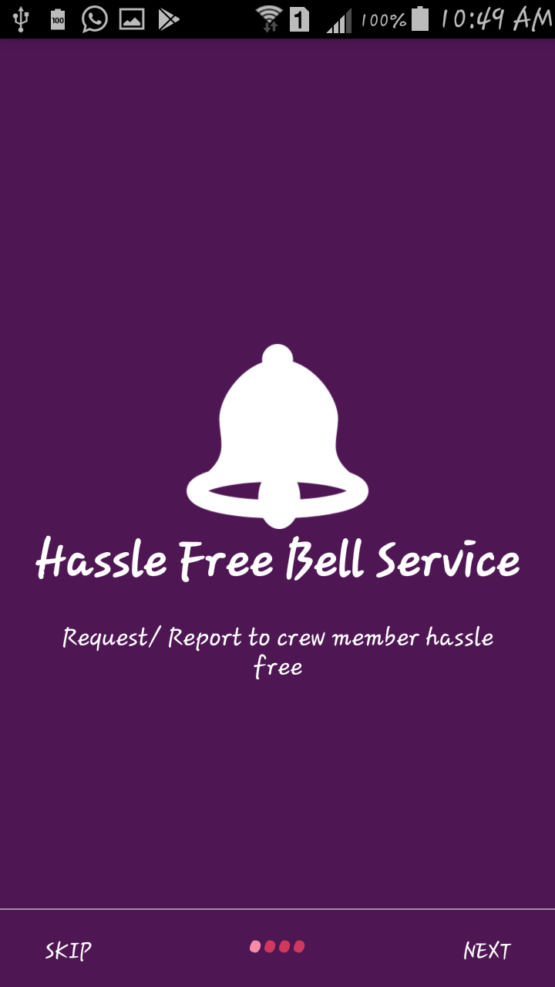
Onboarding Screen 1
Describing different features of the
App For First Time Users

Slide 7
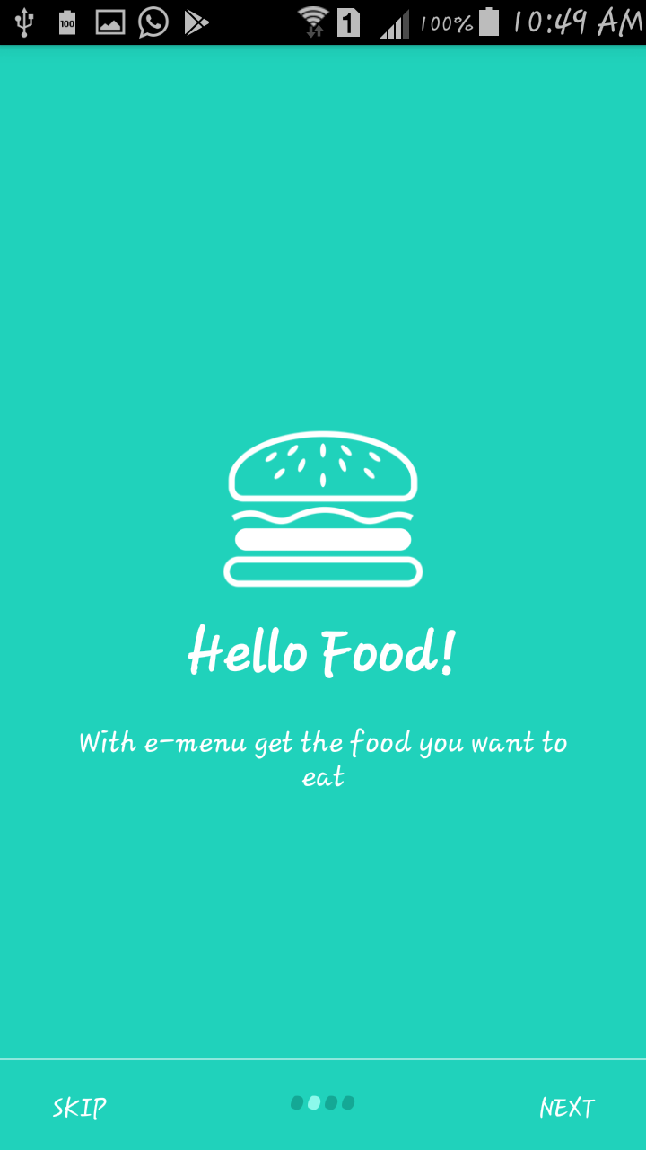
Onboarding Screen 2

Slide 8
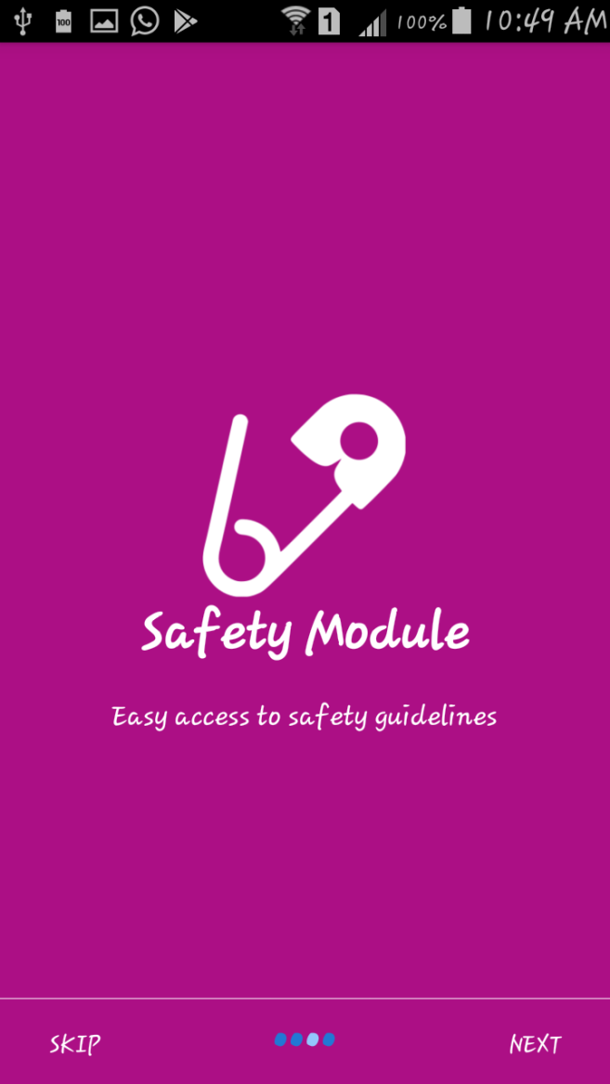
Onboarding Screen 3

Slide 9
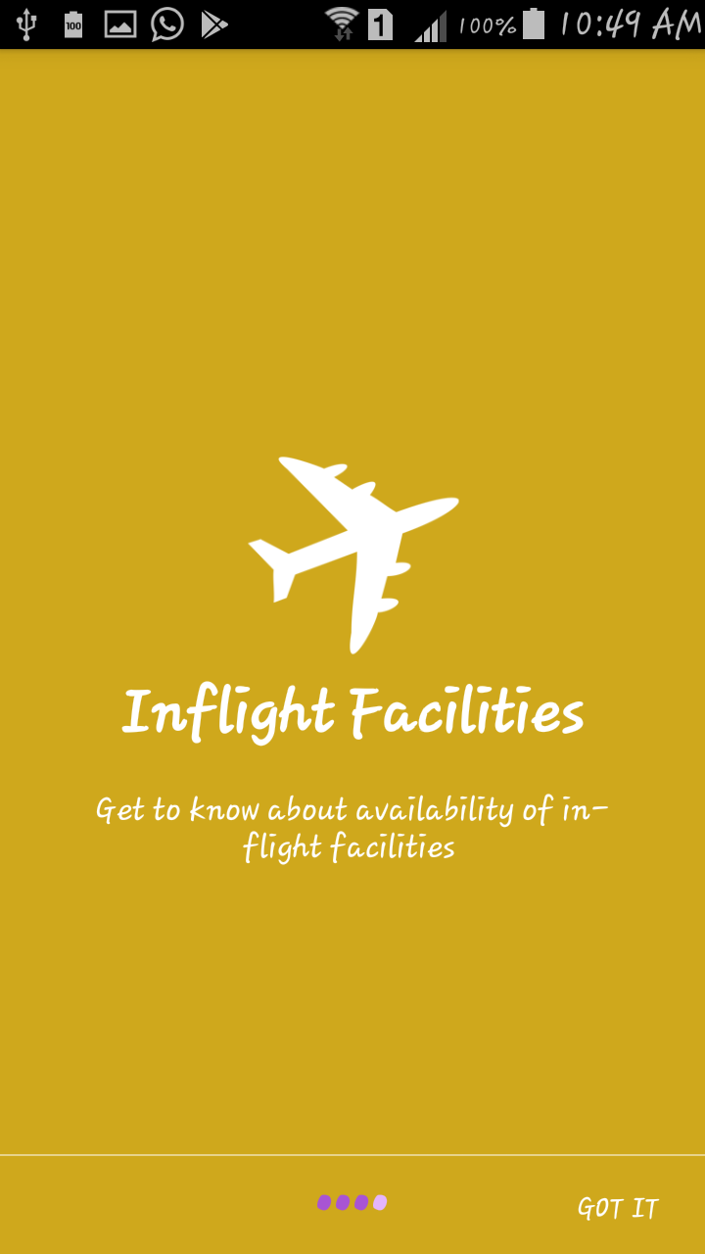
Onboarding Screen 4

Slide 10
Registration to get Passenger Seat Number

Slide 11
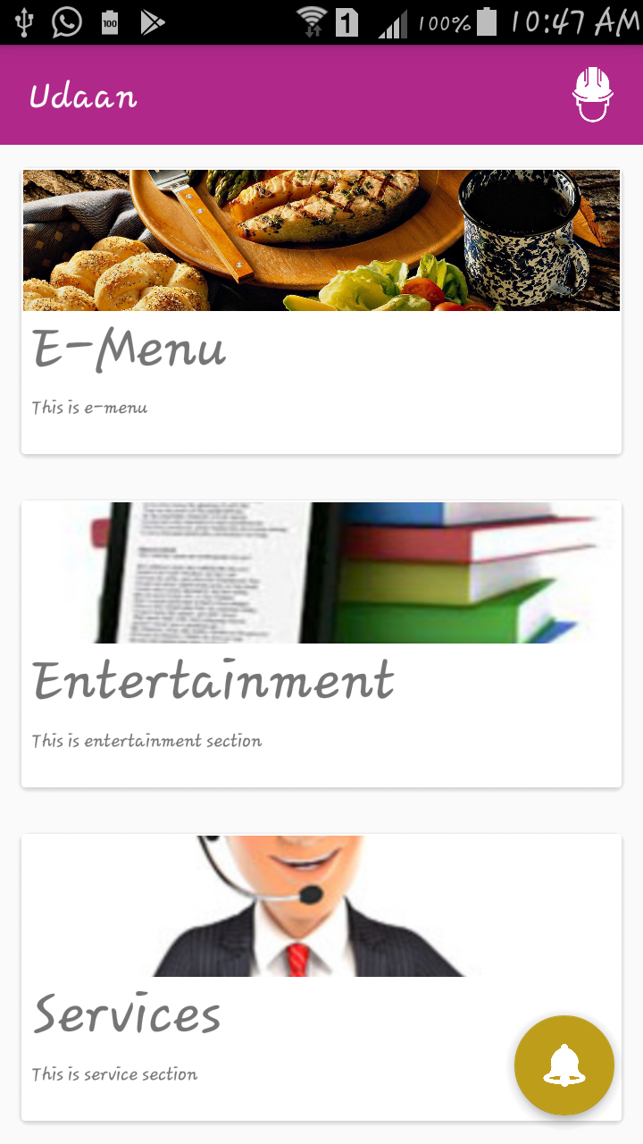
Home Screen

Slide 12
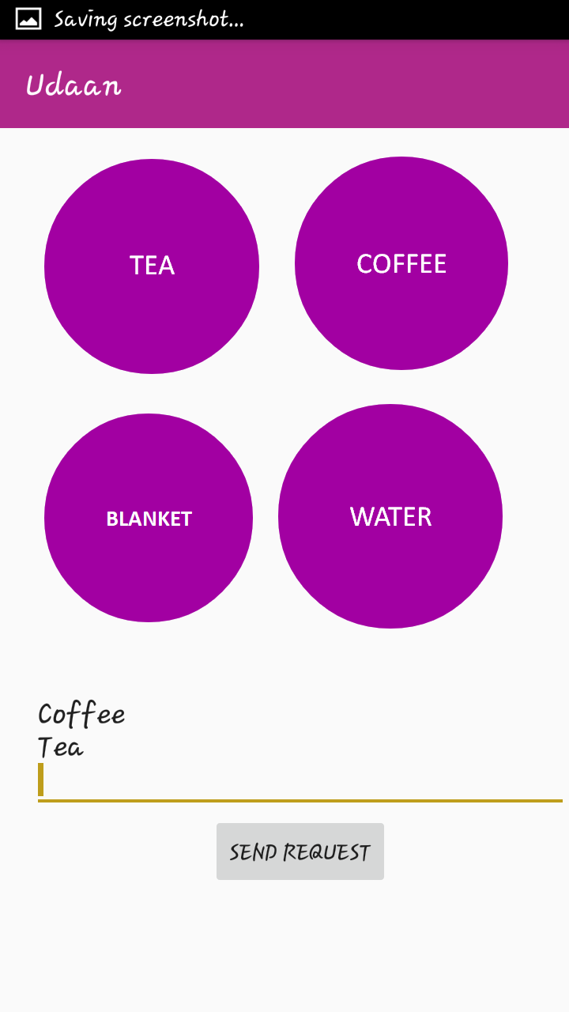
Request/ Calling of Crew

Slide 13
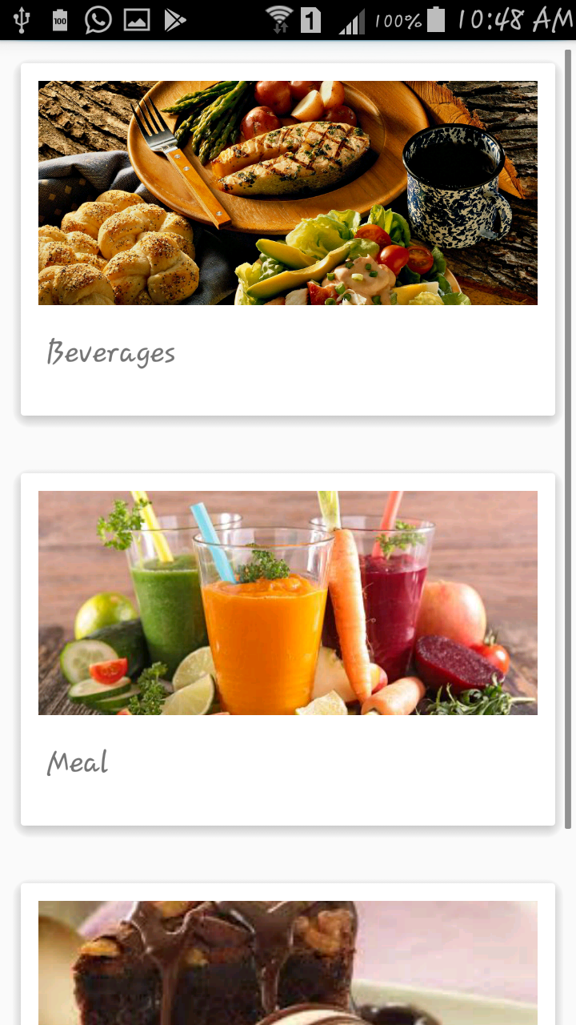
E- Menu

Slide 14
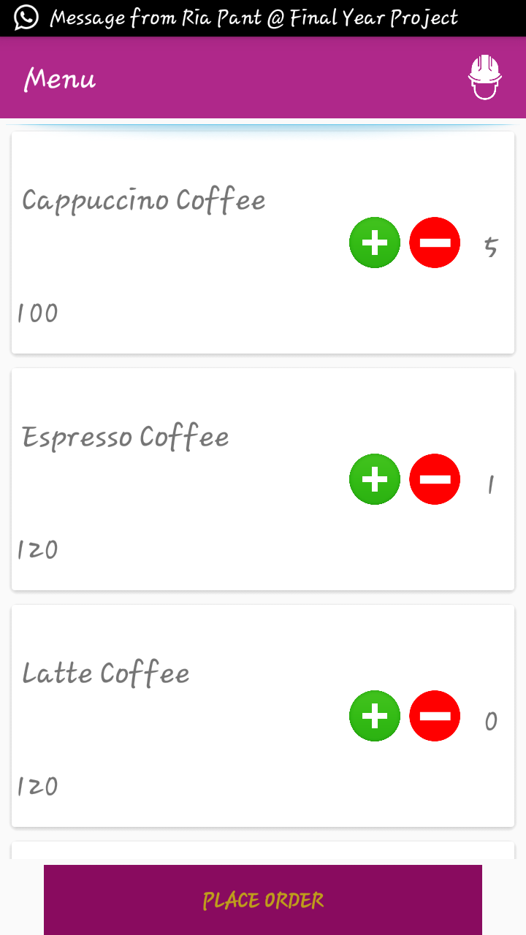
Food Item List in A particular sub-category

Slide 15
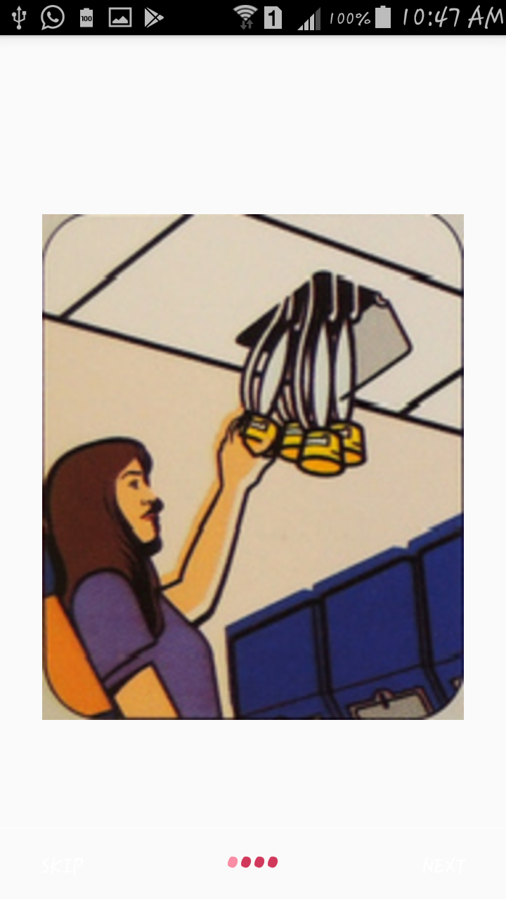
Safety Manual Digitalized

Slide 16
FUTURE SCOPE
Instant app: No need to uninstall or install the app
Use of IoT for better communication between crew member app and passenger app
Keep the user activity log for data analysis

Slide 17
THANK YOU!

